Slide 1
Y4 MTC Workshop

Slide 2
What is the MTC?
MTC stands for Multiplication Tables Check.
It is statutory for all Year 4 children.
It determines whether pupils can recall their times tables fluently, which is essential for future success in maths.
Helps us to identify pupils who haven’t yet mastered their times tables, so that additional support can be provided.
2023 dates: Monday 5th June – Friday 16th June

Slide 3
Format of the MTC
25 questions
Covers all times tables up to 12x12
6 seconds to answer each question
No pass mark – we set children target of 20/25.
https://www.timestables.co.uk/multiplication-tables-check/

Slide 4
Why are the MTC and times tables so important?
Times tables underpin all areas of maths and without secure knowledge and understanding children can encounter basic misconceptions and errors.
A confident understanding of times tables allows children to access all areas of maths therefore giving them a chance to develop their skills in other mathematical areas – rather than times tables being a barrier to their learning and restricting their potential of what they could learn.
Focused mainly on ‘retrieval practice’ which allows children to experience and practice times tables in a ‘little and often’ approach – short bursts which keep children engaged and focused on learning and retaining key times tables information.

Slide 5
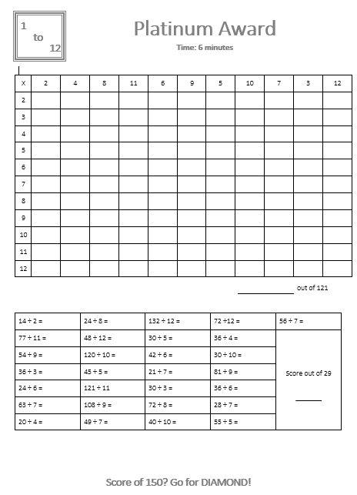
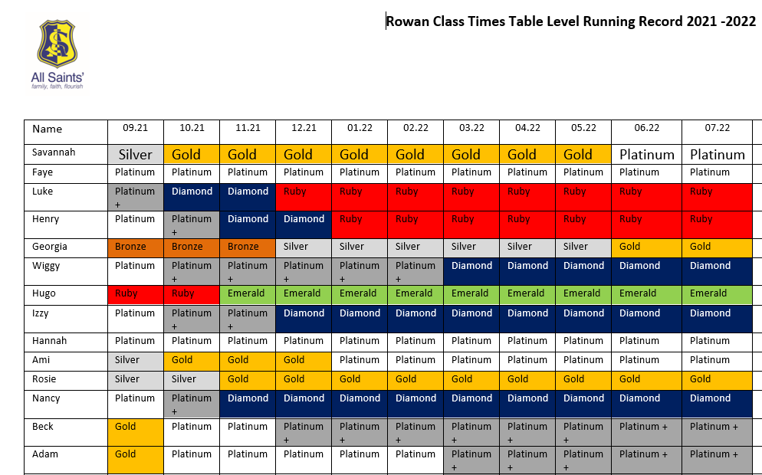
What are we doing in school to help?
Teach times tables daily
Times table award sheets
Times table competitions
Times table monitoring sheets
Mock MTC every month
Times table breakfast club

Slide 6
What can you do at home to help?
Practice times tables:
https://www.topmarks.co.uk/maths-games/7-11-years/times-tables
https://www.timestables.co.uk/
https://www.maths-games.org/times-tables-games.html
Encourage TT Rockstars
Practice MTC mock: https://www.timestables.co.uk/multiplication-tables-check/

Slide 7
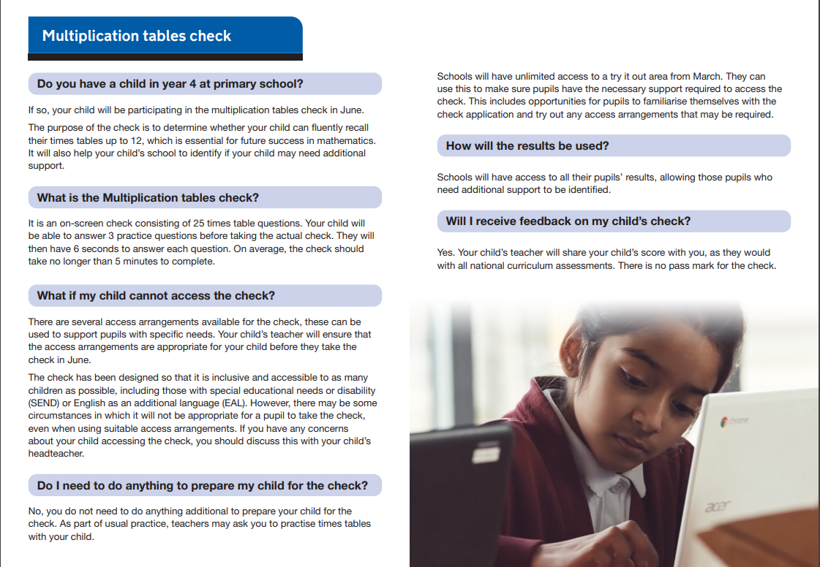

Slide 8

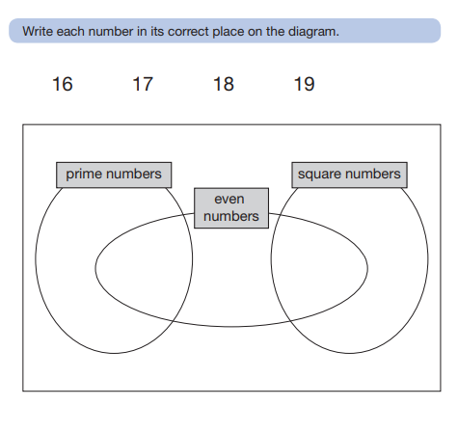
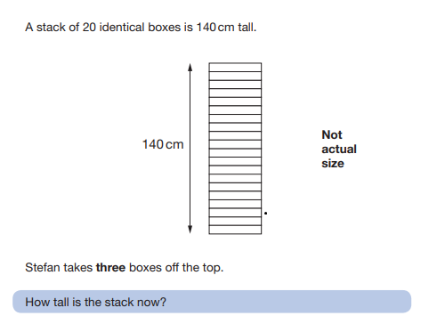
Year 6

Slide 9
Thank you! Any questions?

