Slide 1
Teaching RSE at Key Stage 2

Slide 2
The aim of these lessons is that:
all of children will know more about positive relationships (including friendships, family relationships and relationships with adults and children), and are enabled to:
Be more resilient;
Believe in themselves;
Persevere with tasks;
Work towards long term rewards;
Continue despite setbacks.

Slide 3
We teach PSHE and RSE through a thoroughly planned and progressive curriculum that has been consulted on with parents, teachers and children. The fundamental building blocks of our curriculum are founded in children understanding the characteristics of positive relationships in particular: friendships, family relationships, and relationships with other children and adults. This begins with our children learning about what a relationship is, what friendship is, what family means and who can help them.
Our curriculum builds from the moment our children start school, when they are taught how to take turns, how to treat each other with kindness, consideration and respect, the importance of honesty and truthfulness, saying yes and no, and the idea of personal privacy. This builds into establishing personal space and boundaries, showing respect and understanding the differences between appropriate and inappropriate or unsafe physical contact.
Our curriculum is cognisant of fundamental issues such as everyday sexism, misogyny, homophobia and gender stereotypes and take positive action to build a culture where these are not tolerated. Any occurrences that arise are tackled immediately, our teachers an important role to play in modelling positive behaviours. RSE also creates an opportunity to enable pupils to be taught about positive emotional and mental wellbeing, including how friendships can support mental wellbeing.

Slide 4
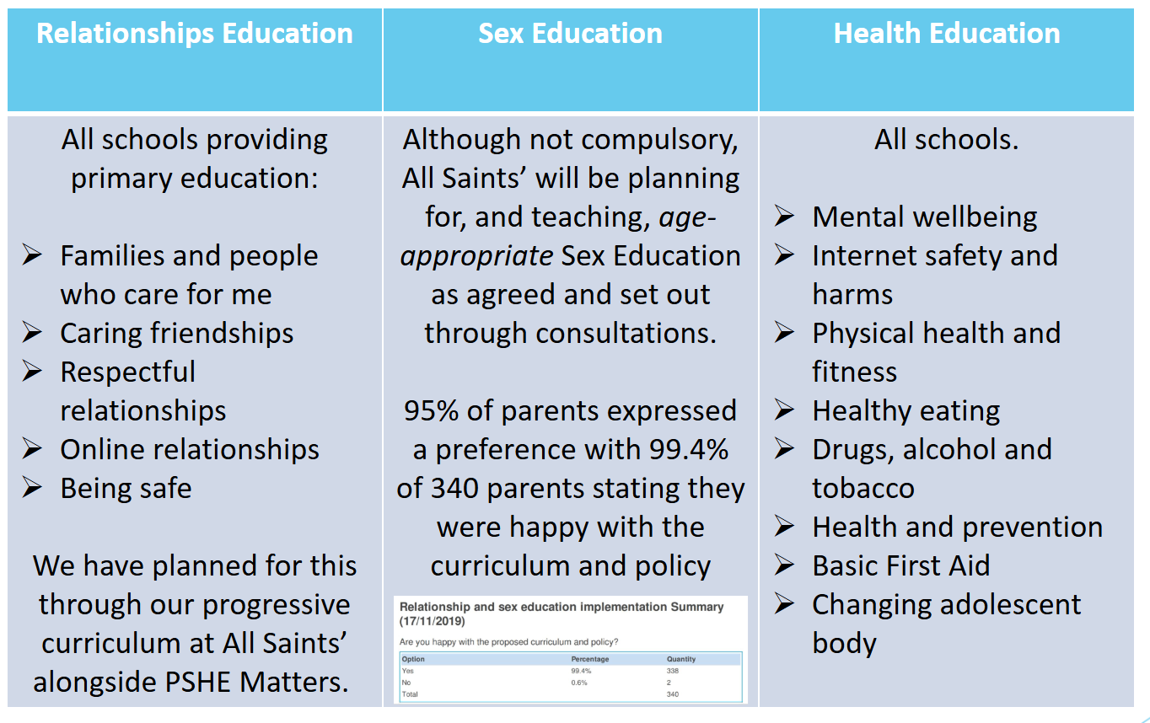

Slide 5
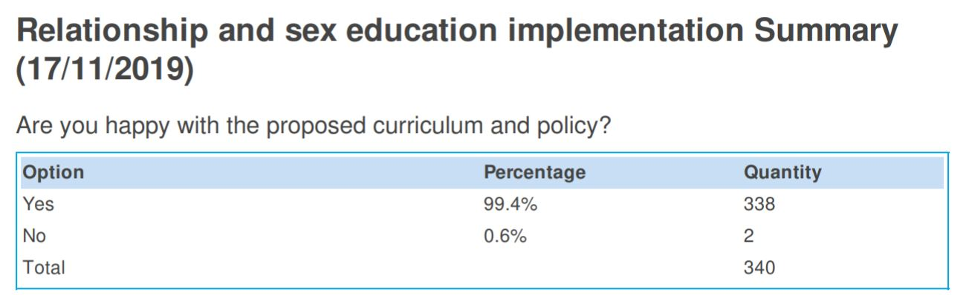
Curriculum
Our PSHE and RSE curriculum was developed in consultation with all members of the school community. Further information on this process can be found here.
Our agreed, progressive curriculum includes units from Derbyshire’s PSHE Matters and our own RSE curriculum, developed in consultation with the community to meet the statutory requirements.
The long-term overviews of key knowledge and vocabulary can be accessed on our website. This details the content children will be taught in PSHE and RSE.

Slide 6
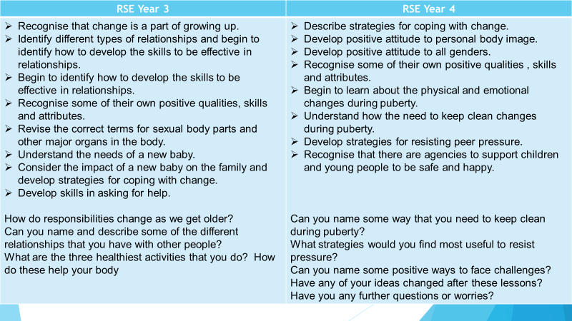

Slide 7
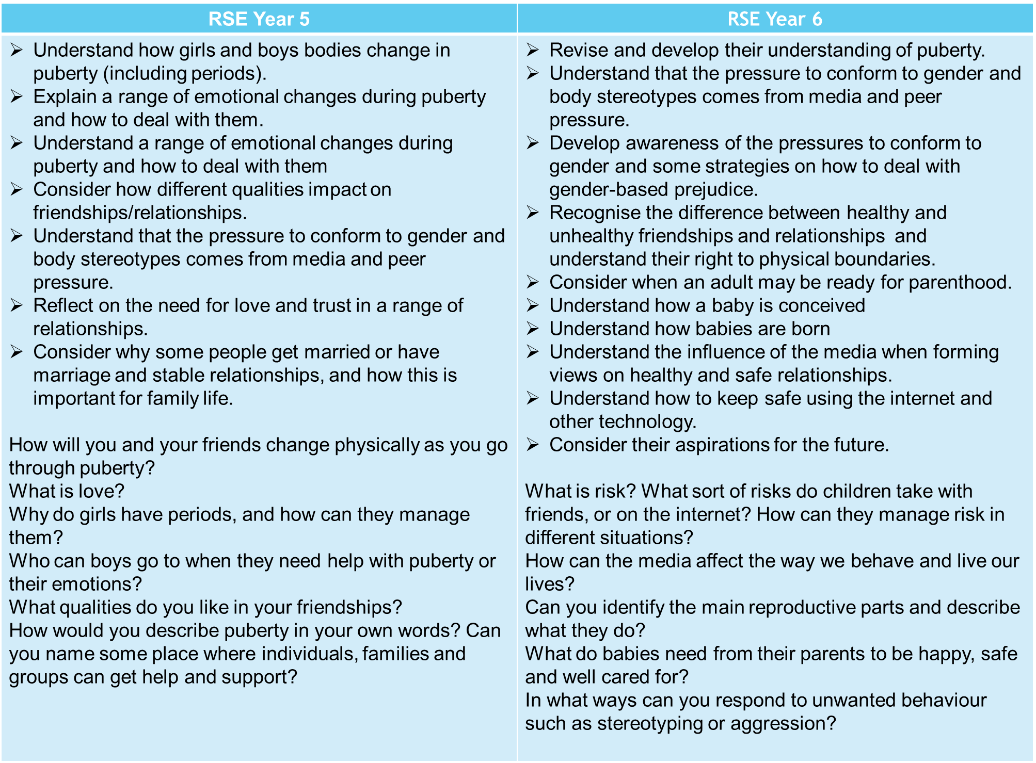

Slide 8
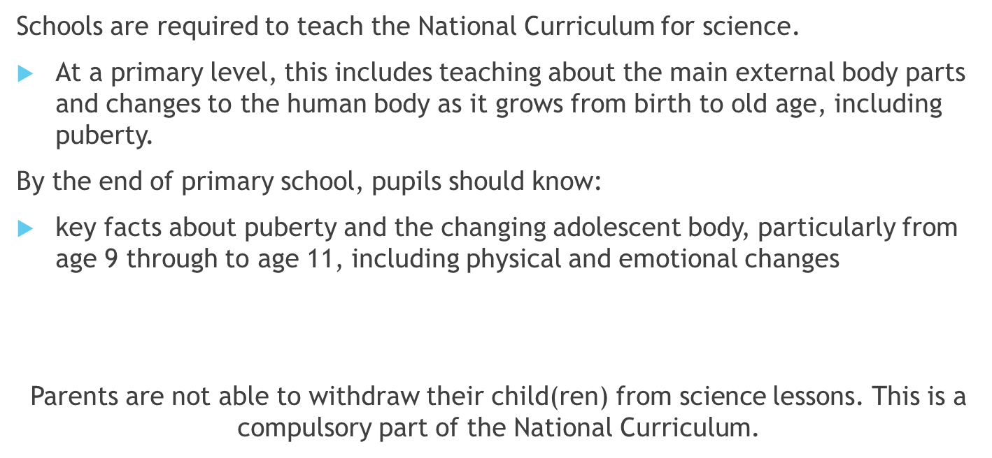

Slide 9







Resources
Websites and video clips to be used:
Dove: Evolution of a model’ video https://www.youtube.com
Operation Ouch http://www.bbc.co.uk/cbbc/shows/
Changes http://archive.teachfind.com/ttv/www.teachers.tv/series/all-about-us-living-and-growing.html

