Slide 1
ECO Council 2024/25
What are our projects for this year and what can you do to help?

Slide 2
Year 3: Biodiversity
Our Aim:
To create an area outside the Year3 classrooms to encourage wildlife and to support biodiversity.
Biodiversity means a variety of living things.
Here is our plan…….

Slide 3
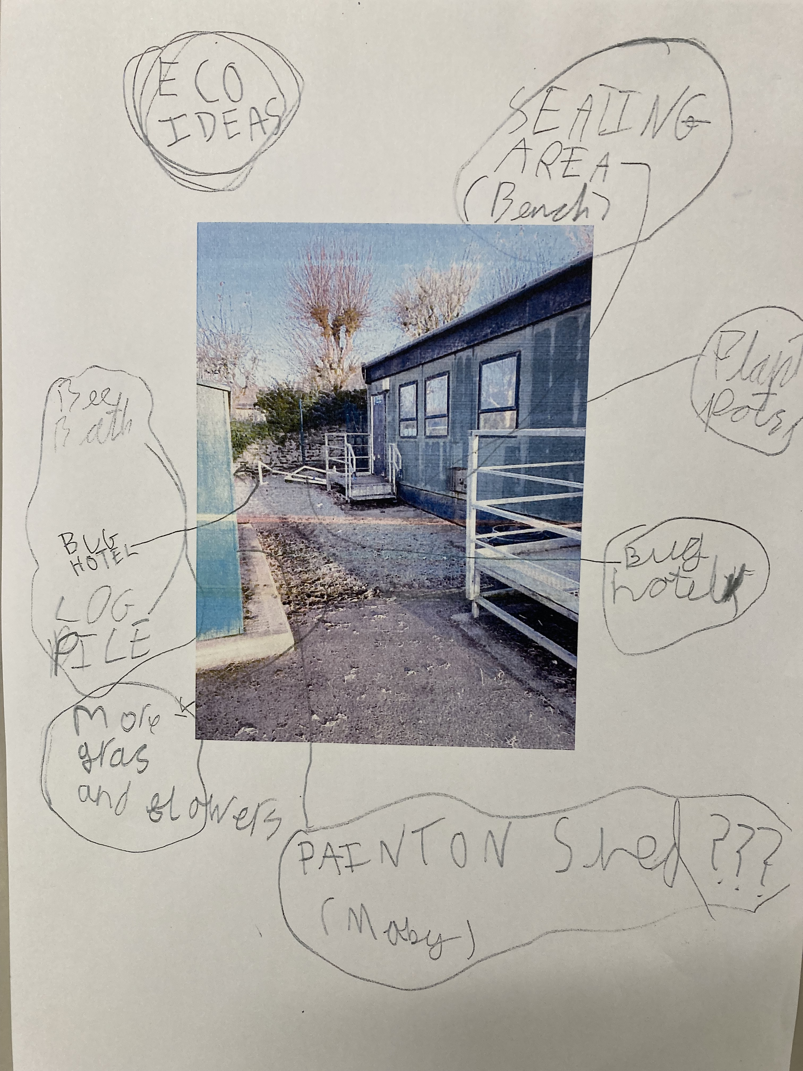

Slide 4
What can you do to help us?
We will need you to respect our area at all times. It is not an area for breaktimes.

Slide 5
Year 4: Energy
Our Aim:
To try to reduce energy costs across the school.
To increase awareness of ways to save energy and have a healthy classroom to work in.
How will we do this and what can you do to help?

Slide 6
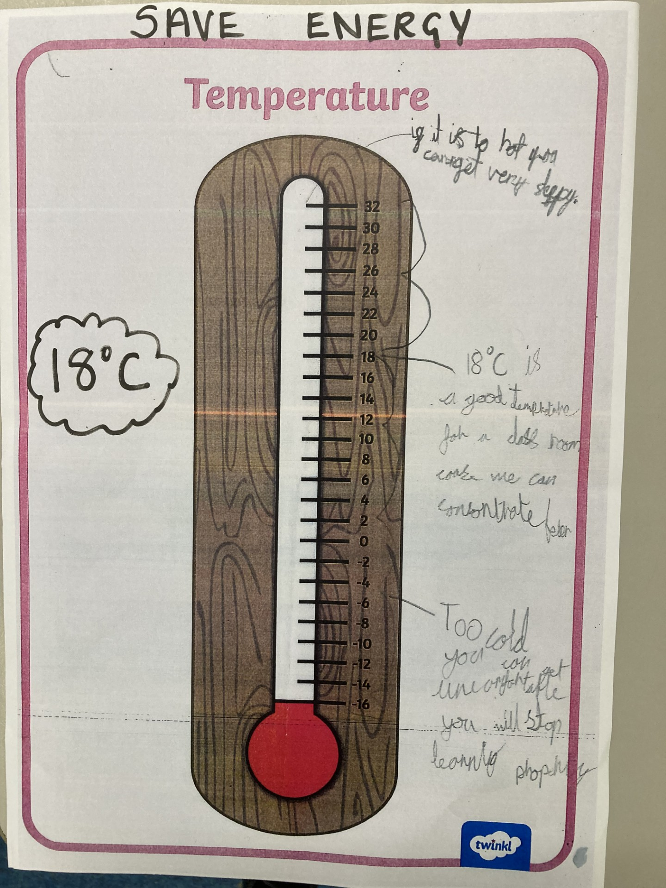
Co2 monitors
Thermometers

Slide 7
Year 5: Litter
Our Aim:
To reduce the amount of litter within our school environment.
What have we discovered so far…..

Slide 8
Year 5: Litter
Our Aim:
To reduce the amount of litter within our school environment.
How will we do this and what can you do to help?

Slide 9
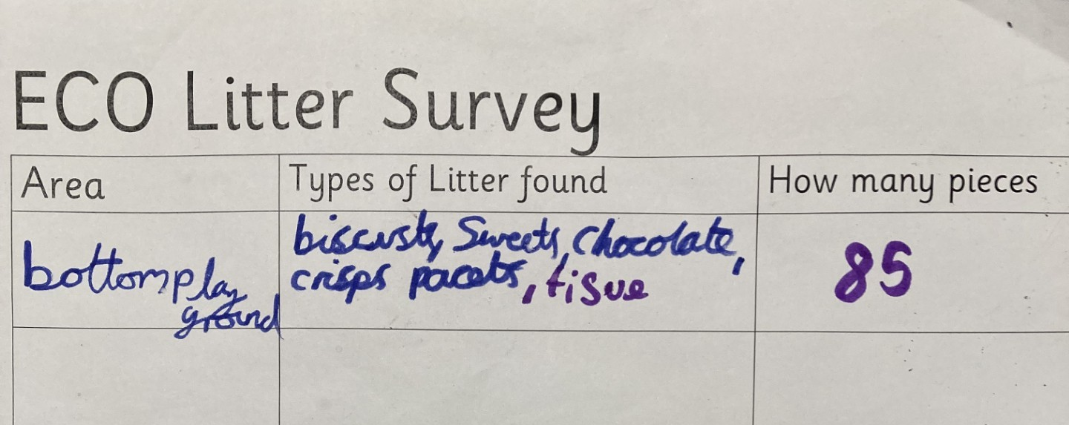

Slide 10
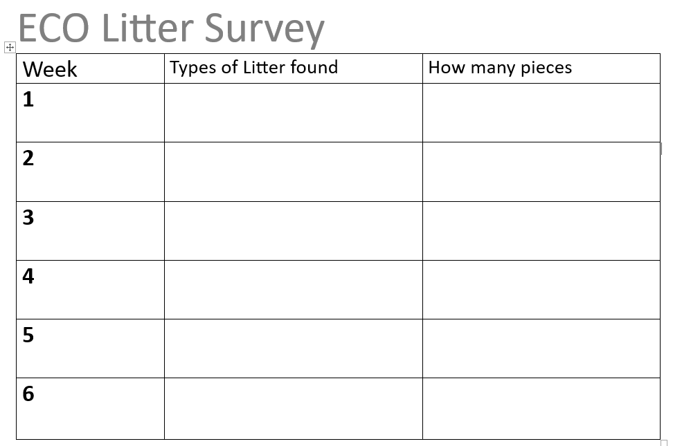
Weekly Litter Pick
Reminder of our Healthy Eating – snacks fruit or vegetable.
Use the bins.

Slide 11
Year 6: Recycling
Our Aim:
To recycle a product that is difficult to recycle at home.
How can you be involved?

